Slide 1
Week 6 (4) – Binary Search and Presorting
CST370 – Design & Analysis of Algorithms
Dr. Byun
Computer Science

Slide 2
Lecture Objectives
After completion of this lecture, you will be able to
  perform a decrease-by-a-constant-factor algorithm that reduces the size of the problem in half.
  conduct sorting to simplify a problem to a different format.

Slide 3
Chapter 4: Decrease-and-Conquer
4.1 Insertion Sort
4.2 Topological Sorting
4.3 Algorithms for Generating Combinatorial Objects
4.4 Decrease-by-a-Constant-Factor Algorithms
4.5 Variable-Size-Decrease Algorithms

Slide 4
Decrease by a constant factor
It is one of the decrease-and-conquer techniques.
  We generally reduce the size of the problem by half (= 50%).
The best known algorithm is binary search.
  To review the binary search algorithm, see the video https://goo.gl/KrX5jD
  The important thing about the algorithm is that the number of elements in the list is reduced by half each time.

Slide 5
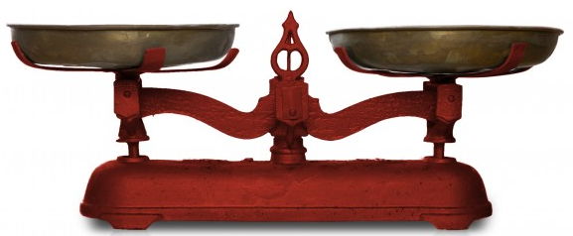
Fake-Coin Problem (1 of 2)
Suppose you have n coins with one fake coin that is lighter than the rest of the real coins.
  How can you find the fake coin using a balance scale?
  Hint: You must consider both odd and even numbers.

Slide 6
Fake-Coin Problem (2 of 2)
If n is an even number, you can divide the coins into two piles of size n/2.
  Weigh the two piles and exclude the heavy pile (= 50% reduction).
  Continue the measurement with another pile.
If n is an odd number, set aside one coin and divide the remaining (n-1) coins into two piles.
  If the two piles are equal, the coin set aside is the fake coin.
  Otherwise, we exclude the heavy pile and continue the measurement with another pile.

Slide 7
<<< Course Instruction >>>
Read pages 150-153 in the textbook and proceed to the next slide.
  This part is relatively simple. However, pay attention to the time complexities of the algorithms.

Slide 8
Puzzle: The Game of Nim (1 of 2)
Suppose there's a stack of 10 coins like below.
  Note that the bottom coin is gold and the rest are all ordinary coins.

Slide 9
Puzzle: The Game of Nim (2 of 2)
There are two players in the game.
  They take turns by removing coin(s) from the top.
  Each player can remove up to four coins from one coin.
  The winner of the game is the player taking the last coin.
  Who will win the game between the first removing player and the second removing player?
  Of course, both players will do their best to win.

Slide 10
Important Note
Do not immediately see the answer on the next page.
Hints
  “10 coins” is too big.
  Consider a stack with a smaller number of coins such as 1, 2, 3, etc.

Slide 11
Solution
The second player always wins.
  If there is one to four coins, the first player always wins because the player can take the last coin at a time.
  If there are five coins, the second player always wins no matter how many coins the first player removes.
  If there are six coins, the first player removes only one coin from the top, and the second player has five coins, which is a losing position to the second player.
  Similarly, in the case of 7, 8, and 9 coins, the first player removes 2, 3, and 4 coins to put the second player in a defeat position (= 5 coins).
  If there are 10 coins in the stack, there is no way for the first player to win because the first player is in another defeat position.

Slide 12
Introduction to Transform-and-Conquer
A transform-and-conquer algorithm solves a problem by a transformation.
There are three different techniques
  Instance simplification
  Representation change
  Problem reduction

Slide 13
Chapter 6: Transform-and-Conquer
6.1 Presorting
6.2 Gaussian Elimination
6.3 Balanced Search Trees
6.4 Heaps and Heapsort
6.5 Horner’s Rule and Binary Exponentiation
6.6 Problem Reduction

Slide 14
Presorting
The basic idea of presorting is that some problems can be solved easily by sorting the input data.
  This is an example of instance simplification.
  Even though we haven’t covered it before, you already used this technique somewhere in the class.

Slide 15
<<< Course Instruction >>>
Read pages 202-203 (Example 1) in the textbook and proceed to the next slide.
  This part is relatively easy to understand.

Slide 16
<<< Course Instruction >>>
This lecture is over.
  When you are done, study the next lesson (week_6_5.ppt) on the iLearn.

